Slide 1

3511B Assignment 2
22101071d Zhu Jin Shun

Slide 2
SWOT ANALYSIS (Personal Development)
Internal Strength Computing background & Bachelor Degree of Computer Science Research project experience collaborating with professors from diverse academic backgrounds Held leadership role in most group projects Sufficient Skills on programming language like C++, Java, Python, MySQL, HTML etc. Gained extensive experience through participation in app development projects and hands-on programming for application creation Receptive to giving and receiving feedback, and identifying areas for improvement in both individual and group work | Internal Weakness Limited expert experience, despite achieving top results in my field of study May adopt a negative attitude and hinder project progress under pressure Struggle with time management across different tasks Lack confidence in decision-making, particularly when in a leadership role Difficulty maintaining patience while working near deadlines Less intern or working experience compared to competitors
External Opportunities University Workshops and training focused on leadership, time management, and technical skill Opportunities to connect with professionals in the industry through events and conferences Access to mentorship from experienced professors for career guidance Participation in hackathons and collaborative initiatives to gain practical experience Join internships in tech companies to gain working experience | External Threats High competition in the job market for tech positions Economic downturns may affect job availability and project funding Powerful AI starting to replace human programmers on progrsmming tasks Possible Potential impact of constructive criticism on confidence and motivation Strict requirement to adapt to quickly changing technologies due to environment
Career Expected: Software Developer

Slide 3
Why choosing this career (Pro and Cons) & What can I do to improve my future career
After conducting a SWOT analysis, I have identified that while I may not excel in management, I am well-suited for a career as a Software Developer, particularly in Software App Development. My Computer Science background and hands-on experience have equipped me with the necessary technical skills. Engaging in software development projects has refined my programming abilities and aligns with my interests, providing a solid foundation for success.
Pros:
Strong demand for Software Developers with competitive salaries.
Opportunities in AI advancements for skilled developers.
A chance to innovate and adapt to new technologies.
Cons:
Job stability concerns due to industry layoffs and economic downturns.
Intense competition from candidates with advanced skills.
Ongoing need for continuous learning to remain relevant.
Steps to Improve My Future Career
To enhance my career in Software App Development, I will focus on continuous learning through online courses and workshops. Building a strong portfolio and networking in tech communities will be essential.
Additionally, I will develop my innovation and problem-solving skills to successfully navigate the evolving landscape of the industry. Also learning and studying for more skills like NoSQL, cloud native related technologies to fit for positions requirement needs.
Meanwhile, I would also seek professional advices from university professors like my academic advisor to gain advice and information from the top experts in the industry.

Slide 4
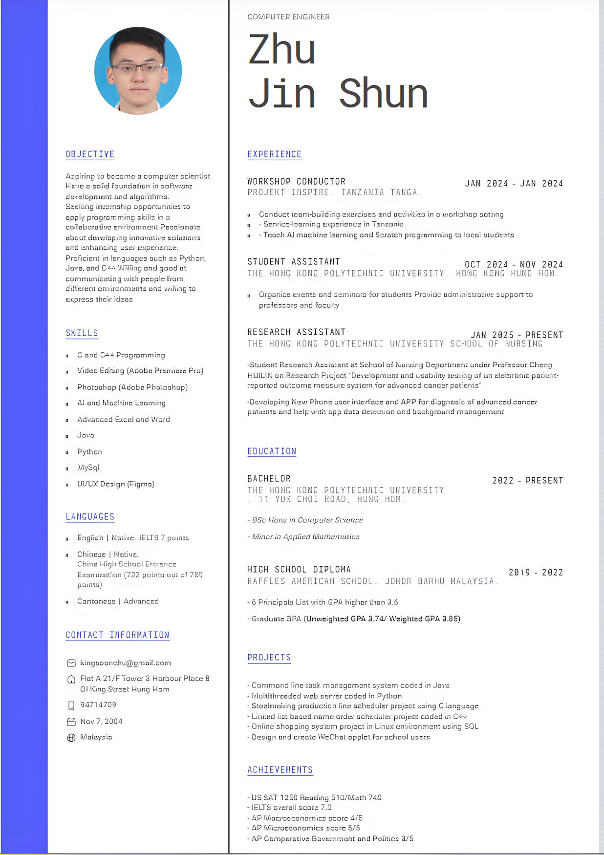
CV and Preparations
Software Developer Job Description: Professional who designs, creates, tests, and maintains software applications or systems. They use programming languages and development tools to build software solutions that meet user needs and solve specific problems.
Software Developer Skills Needed: Programming Languages, Problem-Solving, Database Management, Continuous Learning
LinkedIn: https://www.linkedin.com/in/jin-shun-zhu-a79a52295/
GitHub: https://github.com/KingstonZhu0711

Slide 5
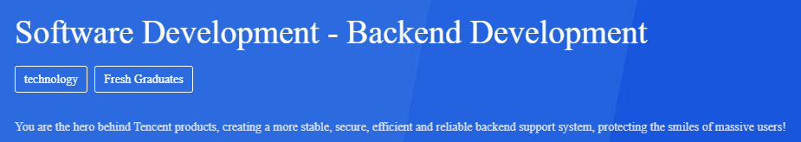

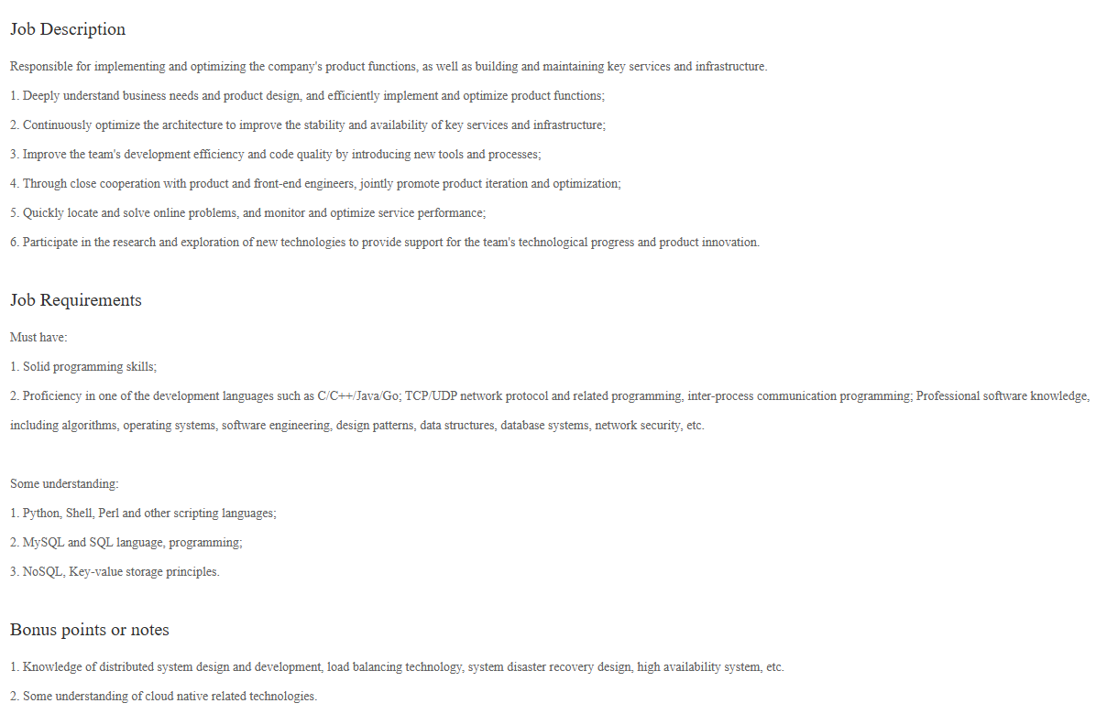


Desired Position Requirements with Current Skills Compared
Desired Company: Tencent
Current Owned Skills
Proficiency in one of the development languages ​​such as C/C++/Java/Go
TCP/UDP network protocol and related programming, inter-process communication programming
Professional software knowledge, including algorithms, operating systems, software engineering, design patterns, data structures, database systems, network security, etc
MySQL and SQL language, programming
NoSQL, Key-value storage principles
Knowledge of distributed system design and development, load balancing technology, system disaster recovery design, high availability system, etc
Some understanding of cloud native related technologies

